Slide 1

Machine Learning Workshop
ACM Meeting 10.31.22
Happy Halloween
Robots taking over the world

Slide 2

What is Machine Learning?
The use and development of computer systems that are able to learn and adapt without following explicit instructions, by using algorithms and statistical models to analyze and draw inferences from patterns in data.

Slide 3

AI vs ML, what's the difference?
Machine Learning is a branch of Artificial Intelligence
Upon successful training on a Machine Learning model, strong Artificial Intelligence is produced
AI is the general ability of computers to emulate human thought and perform tasks in real-world environments, while machine learning refers to the technologies and algorithms that enable systems to identify patterns, make decisions, and improve themselves through experience

Slide 4
Some examples of Artificial Intelligence trained through Machine Learning
YouTube Recommendation
Google Search Suggestion
Ad Recommendations on social media
Siri, Cortana, Alexa
Predictive analytics
  Sports
  Investments
  Weather

Slide 5


DALL-E-2
A machine learning model that takes in a detailed description of an image from a user and generates a very impressive image based on the description
Can also make realistic edits to existing images
The descriptions can be normal English
https://openai.com/dall-e-2/
https://www.craiyon.com/

Slide 6
Types of Learning
Supervised Learning: Machine learning approach that’s defined by its use of labeled datasets. These datasets are designed to train or “supervise” algorithms into classifying data or predicting outcomes accurately. Using labeled inputs and outputs, the model can measure its accuracy and learn over time.
  Classification
    Giving labels to data
  Regression
    Predicting values for data
Unsupervised Learning: Uses machine learning algorithms to analyze and cluster unlabeled data sets. These algorithms discover hidden patterns in data without the need for human intervention (hence, they are “unsupervised”).
  Classification
    Machine is given labels and decides what data falls under those labels
  Association
    Finding similarities in data uses techniques such as clustering
Reinforcement Learning: a machine learning training method based on rewarding desired behaviors and/or punishing undesired ones. In general, a reinforcement learning agent is able to perceive and interpret its environment, take actions and learn through trial and error.

Slide 7
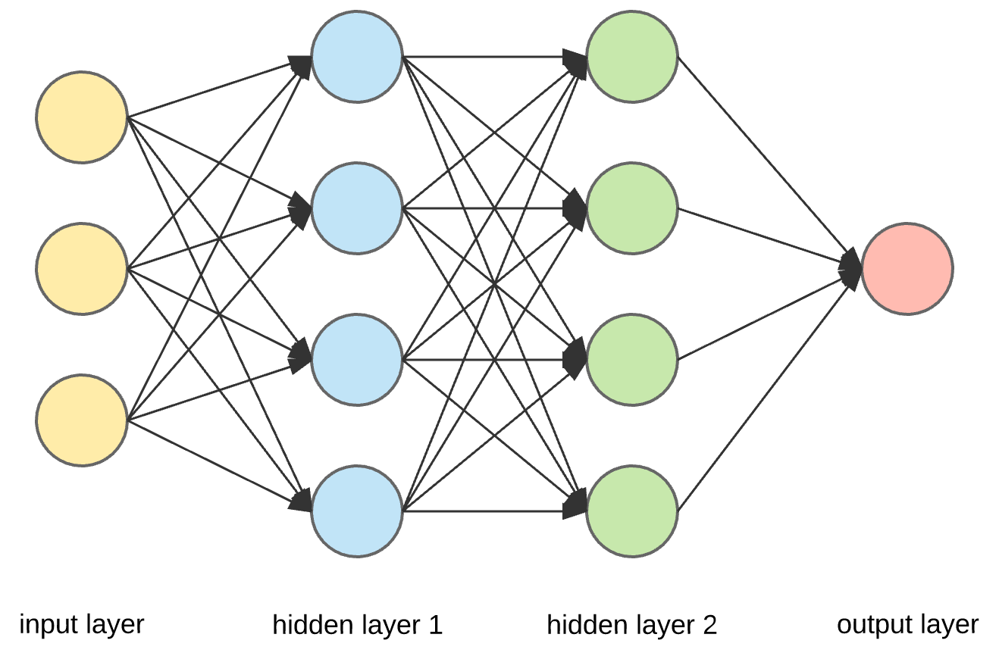
How Does Machine Learning Work?
Modeled after how the brain works
  Machine learning has nodes that represent neurons in our brains
  The nodes pass information to one another in a network
The information passed is a mathematical function
Each node has numerous weights that alter this function
On each pass through the model, an error is calculated based on how far off the output is compared to the actual value
The error is passed backward through the model and weights are adjusted accordingly

Slide 8
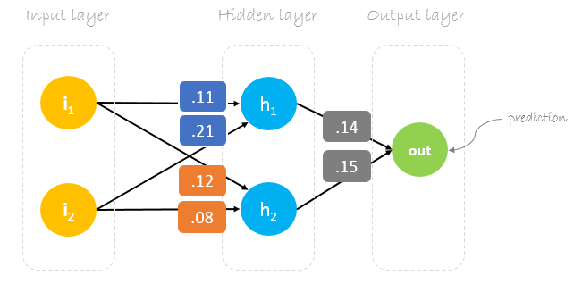
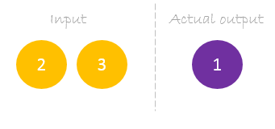

Slide 9
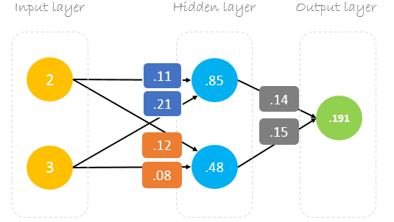

Slide 10
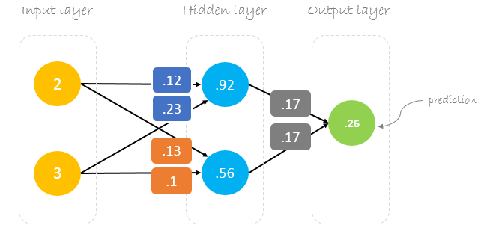

Slide 11
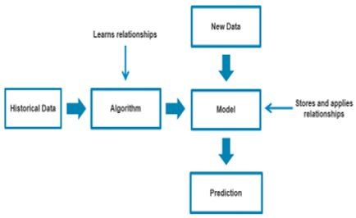
The collection of all the weights in the nodes make up what's called a model
This model improves with each new set of data that you give it to train on
The model calculates the best prediction possible and gives it for output

Slide 12
Overfitting vs Underfitting
Overfitting: the model learns the training data too well and cannot apply it to the test data
Ex: the data you provide is learnt too well and is not applicable
Training: 99% accuracy
Testing: 20% accuracy
Model is too complex and learns too well
Underfitting: the model is unable to learn the training data thus not applying it to the testing data. Ex: the data is not being learned in training
Training: 20% accuracy
Testing: 15% accuracy
Model is not complex enough and fails to learn

Slide 13
How to Create a Machine
Learning Model
Most machine learning is done in Python
There are two main Python packages that people use
  Tensorflow 2: https://www.tensorflow.org/install
  PyTorch: https://pytorch.org/
These packages make it relatively easy to set up the architecture for and train a model
Tensorflow requires NumPy: https://numpy.org/
  NumPy is used for the arrays of data
  Pandas is a data frame package that works well with NumPy: https://pandas.pydata.org/docs/getting_started/install.html

Slide 14
Computer Vision
A field of artificial intelligence that trains computers to interpret and understand the visual world. Derives meaningful information from image data
Examples: Snapchat lenses, medical diagnosis tools, dog breed identify by image app...
Uses deep learning and convolutional neural networks

Slide 15
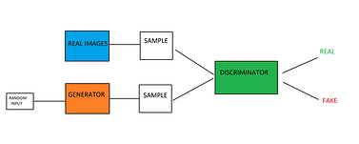
What is a GAN?
An approach to image generation using artificial intelligence
Made up of a Generator and a Discriminator
The two are in competition with one another
Generator tries to fool the Discriminator by producing images that look realistic
Discriminator tries to distinguish between what is a real image and what is a fake image

Slide 16
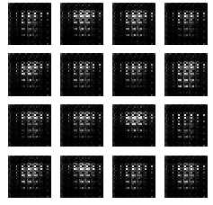
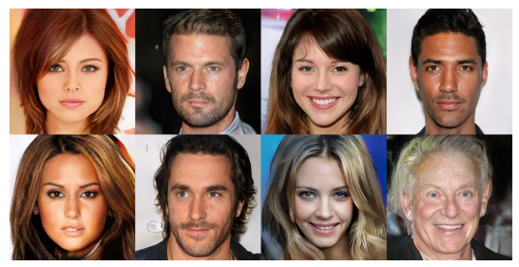
What is a GAN?
Generator is not given access to any real data
Discriminator is given the real images
Both generally learn simultaneously for healthy competition
After some time, the generator can produce images that look real to us

Slide 17
Natural Language Processing
Bridges the gap between human language and machine understanding
Siri, Alexa, Cortana, Virtual Ordering Assistants/Telle-communicators
Uses sentiment analysis to understand
For example, it can read reviews and classify them as positive or negative
Getting to the point where it can understand jokes and sarcasm
Uses neural networks to achieve best models

Slide 18
import tensorflow as tf
def createModel():
model = tf.keras.models.Sequential([
tf.keras.layers.Flatten(input shape = (28,28)), #getting 2d object, make 1d object
#hidden layers
tf.keras.layers.Dense(30,activiation = 'relu'),
tf.keras.layers.Dense(30,activation = 'relu'),
tf.keras.layers.Dense(10)
]) #deep learning model...
model.compile(optimizer = tf.keras.optimizers.Adam(0.001),
loss = tf.keras.losses.SparseCategoricalCrossentropy(from_logits = True),#loss function shape)
metrics = [tf.keras.metrics.SpareCaterogoricalAccuracy()])
return model;
#put into sequence
if __name__ == "__main__":
(train,test) = getDataset()
model = createModel()
mode.fit(train,epochs = 6, validation_data=test)

Slide 19
Another example of Machine Learning Code
https://github.com/Stonehill-GWAIN-PC-Lab/Biome-Model-Scripts/blob/main/scriptToCreatePredictAndEvaluateBiomeModel.py

Slide 20
What opportunities are there in ML?
The number of machine learning jobs are projected to increase by 15% in the next ten years
Most roles required a master's degree and strong mathematics background
Common skills required:
  Python/R programming
  Computer Architecture
  Algorithms & Complexity
  Data Structures
  Operation Systems
  Statistics
  Data Modeling and Analysis skills

